Slide 1
The National FAA Safety Team Presents
Topic of the Month – October 2024
Vestibular and Other Illusions
All AOPA Flying Clubs
Your Club Safety Officer
At Your Next Club Safety Meeting

Slide 2
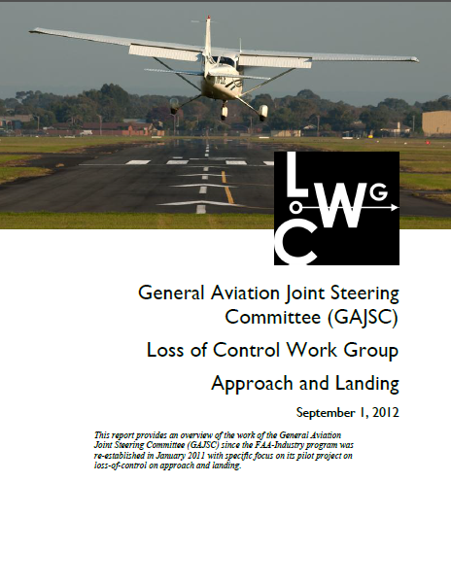
Overview
General Aviation Joint Safety Committee (GAJSC) & FAA Accident Study Findings
Human Information Processing
Illusions
Compendium of information from:
FAASTeam Topic of the Month
Stephen Bateman, various WINGS presentations
Notes:
In this presentation we’ll talk a little bit about recent GAJSC and FAA studies that deal with aeromedical factors identified in a selection of general aviation accident investigations.
I know the program is titled Vestibular Illusions but, before we get to that topic, we need to know a little bit about how humans acquire, process, and decide to act on information. We’ll begin with the four stages of human information processing.
Presentation Note: If you’ll be discussing additional items, add them to this list.
(Next Slide)

Slide 3
Role of the Vestibular System
Humans sense position and motion in three-dimensional space through the interaction of a variety of body proprioceptors, including muscles, tendons, joints, vision, touch, pressure, hearing, and the vestibular system
Feedback from these systems is interpreted by the brain as position and motion data
The vestibular system enables a person to determine body orientation, sense the direction and speed of movement and maintain balance
With limited visual input (common in many flight situations), the vestibular sense becomes important for gathering information. However, the vestibular system is designed to work on the ground in a 1G environment and therefore during some flight maneuvers can provide flight crews with erroneous or disorienting information
https://skybrary.aero/articles/vestibular-system-and-illusions-oghfa-bn
Notes:
In order for pilots to make decisions and act on them they gather, assess, and prioritize information from their senses, knowledge bases, and life experiences.
We’ll begin our discussion with an overview of how our information processing system works and how a process intended to lead to success can occasionally contribute to failure. (Click)
Human information processing is accomplished in 4 stages:
Sensing – Gathering information through our senses of sight, hearing, position, touch, taste, smell, etc.
Perceiving – Giving meaning to our senses
Deciding – Determining what actions to take
Acting – Taking action
Let’s consider how these information processing stages work.
(Next Slide)

Slide 4
Humans and Information
Sensing
Gathering information thorough our senses
Perceiving
Giving meaning to the sensory inputs
Deciding
Determining what action to take
Recall or work it out
Acting
Doing something about it
Notes:
Presentation Note: Here’s where you can discuss venue logistics, acknowledge sponsors, and deliver other information you want your audience to know in the beginning.
You can add slides after this one to fit your situation.
(Next Slide)

Slide 5
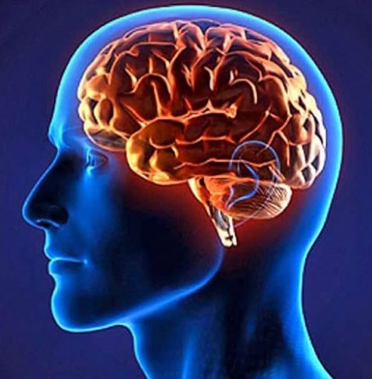
Brainiac Flying
Understand how our ground-based brains try to kill us in the air

Slide 6
This Is Really Interesting…
“Important decisions made by intelligent, responsible people with the best information and intentions are sometimes hopelessly flawed.”
“Many people are overconfident, and prone to place too much faith in their intuition.”
“Being good at thinking, can make you worse at rethinking”
Adam Grant

Slide 7
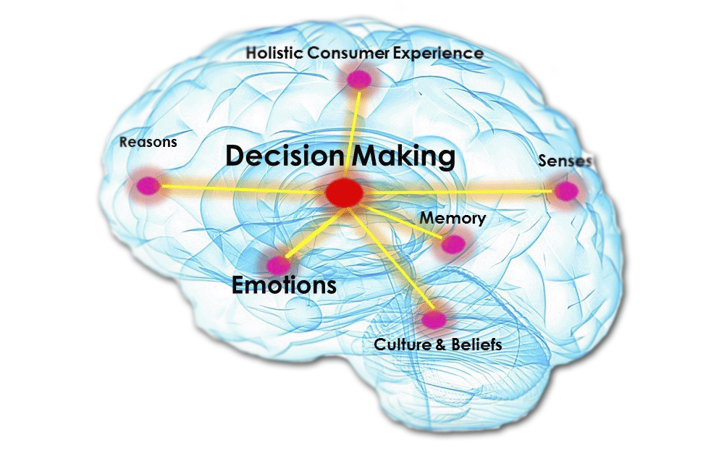
Understanding Human Decision Making
Two “systems” operate in our brains for decision making:
Experience based
Low effort, so preferred
Automatic, quick
“Jump to a conclusion”
Based on similar previous experiences
But is it really similar…how close…?
Perception versus reality
Rules most of what we do
Computation based
Requires mental activity and effort
“Have to think about it…”
Contemplate complex choices
Reluctant to engage and overrule “experience”

Slide 8
A Simplified “Blueprint” of Mental Functioning
Perceiving & Deciding
Sensing
Acting
Filters
(Distractions, pattern matching, experience, emotions…)
Conscious Workspace
Actions: Hands, Feet, etc.
Input Functions
Output Functions
Sensory
Inputs
Long-term memory
(Knowledge base)
James Reason & Alan Hobbs (2003)
Feedback Loops
Notes:
We’ll start with a blank sheet of paper & draw a blueprint of Human Mental Functioning. There’s a lot more going on than we’ll discuss here but this will give you an idea of how we process data. (Click)
This is a bit like a circuit diagram or flow chart…
Inputs – from the senses: Sound, vibration, smell, sight, vestibular
Primarily through our sense of sight and our other senses, data is conveyed to 2 areas of our brain. (Click)
It flows to the Conscious Workspace – think of it as your CPU…limited capacity, knows most about what happened recently. Stuff flows in and out with little long-term retention.
(Click)
…but we have to be paying attention. The world is a very complex place and our brains do a wonderful job of filtering out unimportant details…
“lost in thought”, over-comfortable cabin and noise cancelling headphones)!) We could term this “our level of paying attention” so even if something is happening, we may not “perceive” it.
If we’re preoccupied with something else the attention filter won’t let the data through.
(Click)
Sensory data also flows to our long-term Memory – sort of like the storage memory of our computers. (Click)
and – like our computers - data is exchanged between the Conscious Workspace and Long-term Memory…as long as:
It is there in memory. If we haven’t experienced it, probably not there at all…
We know how to get at it…how to associate what is happening with a similar scenario. Do we have the right “memory address” to get the information…
(Click)
Processing results in output functions assigned to speech, movement, etc.
In other words, our response.
Could be fast and correct if we have seen it and practiced it before
Could be slow if we have to “hunt about” in memory to find a response
If not found (or the wrong address) could lead to an inappropriate response.
(Click)
Then, our response does things that change the way the airplane is behaving – and so how we sense it…a feedback loop that reports how our response is changing things – not necessarily in the right direction.
This is like the DECIDE model…something happens, we list some actions, pick one, do it, and see what happed. Repeat.
(Next Slide)
Background:
A 'Blueprint' of Mental Functioning
This slide outlines the basic structural components of mental functioning. It is not a wiring diagram or a picture of brain anatomy, rather it is a very simplified 'systems representation' of the important elements and their inter-connections. Sensory data comes into the brain via a number of input functions. These are the senses—vision, hearing, taste, touch, smell and the various position and motion receptors. Vision is the dominant sense, so much so that it can override conflicting inputs from the other senses. A small proportion of the total available sense data enters the conscious workspace after having been screened by the attention filter. Here, the selected data are broken down, added to or recombined by the computationally powerful (though slow and effortful) processes of thought, reasoning and judgment. The conscious workspace can act directly upon the various output functions—hands, limbs, feet, speech and so on—commanding them to perform certain actions or utterances.
Some of the input data passes directly to long-term memory, the knowledge base, where highly specialized knowledge structures or schemata act upon it. Whereas the conscious workspace keeps 'open house' to all kinds of sensory data, long-term memory seeks out only those pieces of information that are relevant to its stored knowledge structures. Each schema 'looks out for' only those bits of information relating specifically to it. Thus, a schema for recognizing cats is only interested in things having a certain size and shape, four legs, sharp claws, fur, whiskers and the like.
Information from long-term memory goes two ways.
• First, it can go directly to the output functions in the form of pre-packaged bursts of instructions. In engineering terms, we can say that whereas action control via the conscious workspace is feedback-driven, that via long-term memory is feedforward-driven. We will look at these control modes in more detail later.
• Second, the long-term memory is continually sending information to the conscious workspace. Sometimes, this information is deliberately sought by conscious retrieval mechanisms, but often items of information just pop into consciousness, seemingly of their own accord, but actually driven by the two basic search rules of similarity matching (match like to like) and frequency gambling (where two or more items have been located on the basis of similarity, favour the one that is most frequently and recently used in this situation).1 An item of information thus delivered might be a thought, an image or an action.
The conscious workspace (CW) and long-term memory (LTM) usually operate in subtle harmony to guide our actions in the way that we intend. Sometimes things go wrong, but this happens comparatively rarely. The characteristics of these two controlling mechanisms (CW and LTM) stand in marked contrast one to another.
Limitations of the Conscious Workspace
An important difference between the conscious workspace and long-term memory is that the capacity of the conscious workspace is severely limited. When you look up a phone number and keep it in mind until you dial it, you are depending on the conscious workspace. Mental arithmetic is another situation where we have to keep several items stored in memory until we have found the answer. The conscious workspace has a time span of around one-and-a-half seconds, and operates like a leaky bucket. New bits of information or thoughts displace older items of information. The limits of the conscious workspace have important implications for maintenance work. Interruptions and other distractions can easily lead to steps being omitted and other failures of memory. James Reason and Alan Hobbs 2003

Slide 9
In a Nutshell…
If we’ve seen it before (and can get at it), we can quickly, respond to a situation (sometimes correctly and successfully)
If we haven’t seen it before (or can’t get to it—shelf life) we must compute, which is slow, trial and error, and really difficult to retrace once we are heading down a (wrong) path
This DEFINES proficiency in three important ways:
We must train in order to have new things in our memory/muscle banks
We must regularly practice in order to get better, but more importantly, to have it available for recall
We must train using scenarios to form associations
Learn new things and practice old things

Slide 10
Conscious Workspace: Think and Store
A
B
C
B
C
A
10
Notes:
You don't immediately recognize this, so start to think about what it might be…already generating a bias…
To illustrate how this works let’s take a trip to the Conscious Work Space.
Stay within the yellow lines (Click)
and connect A to A, B to B, and C to C with continuous lines that don’t cross.
Use paper and pencil if you like and raise your hand when you’ve solved the problem. You are now working in the Conscious Work Space.
Presentation note: Give the audience some time – at least a minute - to work the problem then:
You are now in the Conscious Work Space. Are you comfortable working there? How comfortable would you be if you were processing information this way while driving a car or landing a plane?
Obviously we can’t function in the Conscious Work Space exclusively. It’s too slow and ponderous to live life this way and yet ….. we have to go there unless wecan run a program from our Long Term Memory. We’ll get to that in a minute but first, here’s how the problem is solved. (Click) (Click) (Click)
Then play it again. This time we know what to do (long term memory stored the answer) so we do it quickly…”recall”.
(Next Slide)

Slide 11
Retrieve Versus Compute
3 x 3 =
3 x 3 = 9
2 x 2 =
2 x 2 = 4
Seen this many times…
Not a trick question…!
Wait…that looks a bit different…let’s think about it a bit…
11
Notes:
While working in the conscious workspace is sequential, slow, and laborious, accessing long term memory is virtually effortless and astoundingly quick. Here’s an illustration. Just complete the statements aloud:: (Click)
Presentation note: Pause briefly for the audience to complete each statement. Then move to the next statement
Right – we all remember the nursery rhyme. (Click)
And in this age of calculators in everyone’s pocket or purse we still remember multiplication tables. (Click)
Right again. The square of the hypotenuse of a right triangle is equal to the sum of the squares of the two adjacent sides. Some of us had to access our memory attic for Pythagoras’ Theorem but you get the point.
There’s another aspect of long term memory that helps us make sense of the world and it has to do with association.
(Next Slide)

Slide 12
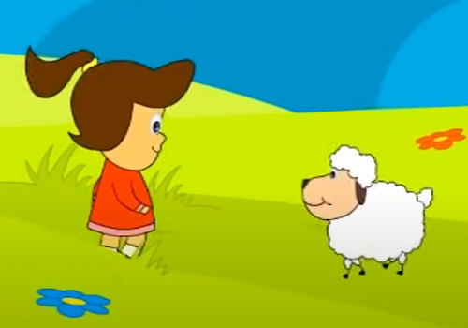
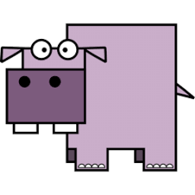
Long Term Memory
Mary had a….
The square of the hippopotamus of a right-angle triangle is equal to…
Learn (often, drill), store, retrieve…
Shelf life if not used:
Forget or slow to retrieve
If stuck, needs associations smells, images, music…
12
Notes:
Why were the Adjacent and Hypotenuse unable to accept a package without each other?
Because they had to…cosine
While working in the conscious workspace is sequential, slow, and laborious, accessing long term memory is virtually effortless and astoundingly quick. Here’s an illustration. Just complete the statements aloud:: (Click)
Presentation note: Pause briefly for the audience to complete each statement. Then move to the next statement
Right – we all remember the nursery rhyme. (Click)
And in this age of calculators in everyone’s pocket or purse we still remember multiplication tables. (Click)
Right again. The square of the hypotenuse of a right triangle is equal to the sum of the squares of the two adjacent sides. Some of us had to access our memory attic for Pythagoras’ Theorem but you get the point.
There’s another aspect of long term memory that helps us make sense of the world and it has to do with association.
(Next Slide)

Slide 13
Sensing
Sight
Hearing
Feeling
Balance
Vestibular system
Notes:
Our brains interpret and integrate information from our visual, auditory, and vestibular systems to determine the body's condition and its interaction with the environment. Let’s take a closer look sensing systems.
(Next Slide)

Slide 14
Sight …
the primary information source for most people
Notes:
Sight is our primary information source when we fly and in most of our activities. In the eye, light passes through a lens that focuses images on the retina. Some image processing takes place in the eye before the optic nerve transmits images to the brain where they are further interpreted.
(Next Slide)

Slide 15
Sight Can Be Distorted
Awareness and compensation for visual deficiencies and illusions
Notes:
The way we see objects can be distorted by physical attributes of the eye and also by the way the brain processes visual images, so pilots must be aware of and compensate for visual deficiencies and illusions. Let’s look at some of the visual challenges that pilots face.
(Next Slide)

Slide 16
Visual Challenges For Pilots
Bright light
Can compromise central and color vision and cause temporary blindness or permanent visual impairment
Low light
Reduces central and color vision. Objects may only be visible with peripheral vision
Blind spots
Present where the optic nerve is attached to the retina
Empty-field Myopia
When there are no distant objects to focus on, the eyes will focus at 3 to 6 feet. Traffic will appear to be smaller and more distant it is
Transition from IMC to VMC (when landing)
Dirty windshield or windows
Notes:
So, what are some common visual challenges we face and what do we do about them? (Click)
Bright light...
can compromise central and color vision and cause temporary blindness or permanent visual impairment.
Wear high-quality sunglasses and avoid looking directly at the sun or other bright light sources. (Click)
Low light...
reduces central and color vision. Objects may only be visible with peripheral vision.
Develop an effective scan pattern
Avoid bright lights. Keep cockpit illumination low to preserve night vision.
Approximately 30 minutes are required to adapt from day to night vision. Once adapted, exposure to bright light will re-start the cycle. (Click)
Blind spots...
are present where the optic nerve is attached to the retina.
Develop an effective scan pattern with short (1 to 2 seconds), regularly spaced eye movements that bring successive 10º segments of the sky into the central visual field.
Be aware that peripheral vision is better at detecting movement than direct vision. (Click)
Empty-field Myopia...
occurs when there are no distant objects to focus on. The eyes will focus at 3 to 6 feet. In this state, traffic will appear to be smaller and more distant than it is.
Focus regularly on a distant object. If there is nothing to see out of the windows, focusing on a wing tip will do. (Click)
Transitioning from IMC to VMC...
Quickly focus on runway features or approach lights.
Be prepared to quickly transition back to instruments if a missed approach is required. (Click)
Dirty windshield or windows...
Keep clean and scratch free to avoid focusing on imperfections.
(Next Slide)

Slide 17
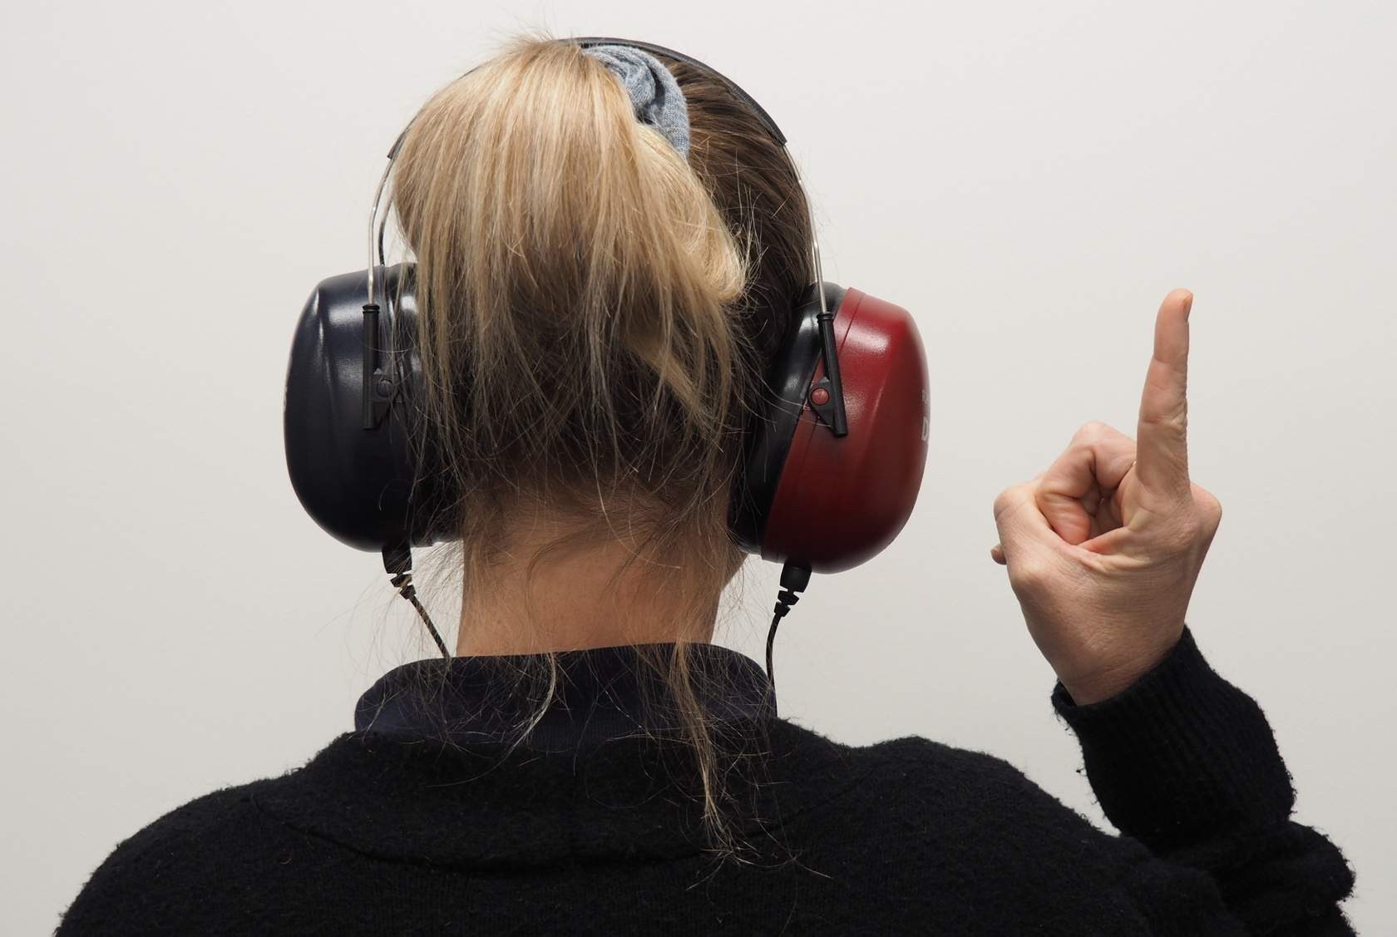
Hearing… Essential for many communications
Often the first indication that something’s not quite right with our aircraft
Also other types of vibration
Notes:
Our sense of hearing is essential for many, if not most, aviation communications and it's often the first alert to something not quite right with our aircraft.
As we age, we all experience some degradation in our hearing - particularly in the high frequency range. Exposure to noise accelerates the process, so pilots are advised to use hearing protection such as noise isolating or noise cancellation headsets.
(Next Slide)

Slide 18
Balance … Sensors in each ear
Motion
Balance
Stabilize eyes
Notes:
Balance sensors are located in each ear. Three interconnected vestibular organs consisting of fluid-filled semi-circular canals and sensory hairs, help us to sense motion, maintain balance, and stabilize our eyes as we move.
The vestibular system does an excellent job of maintaining balance on the ground, but it's not as reliable in the air, so pilots must learn how to identify and compensate for occasional inappropriate sensations of turning and spatial disorientation.
(Next Slide)

Slide 19
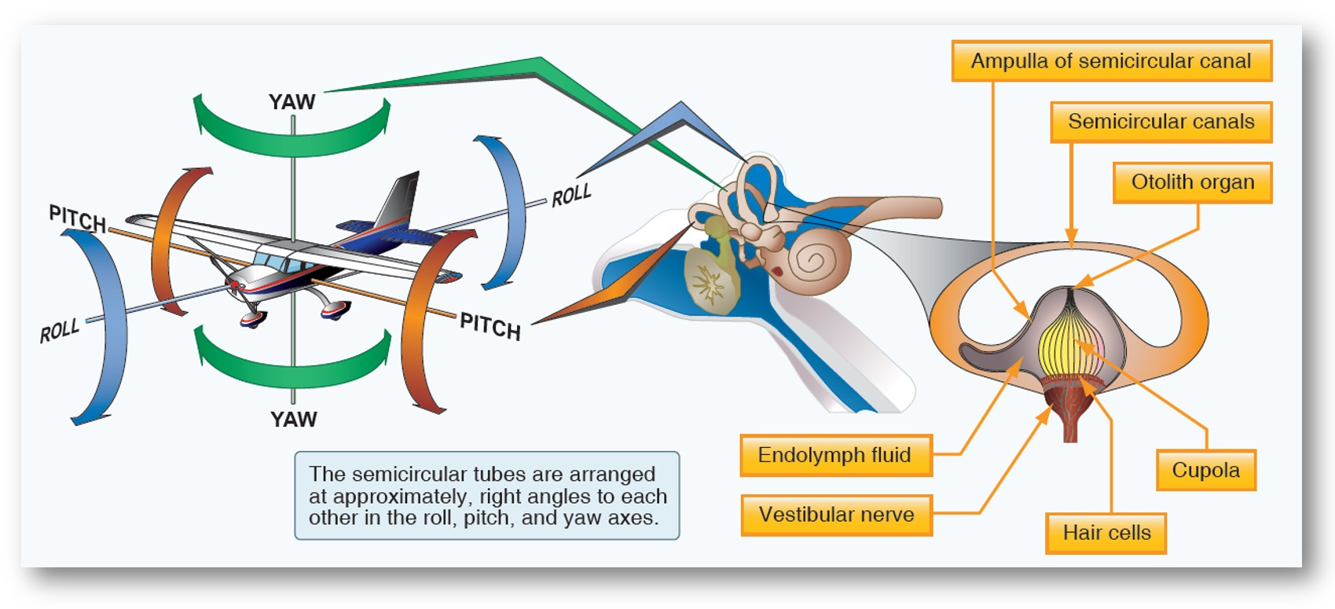
Notes:
Let’s take a closer look at the inner ear. This illustration is from the Pilots’ Handbook of Aeronautical Knowledge.
The vestibular system in the inner ear allows the pilot to sense movement and determine orientation in the surrounding environment. (Click)
In both the left and right inner ear, three semicircular canals are positioned at approximate right angles to each other. (Click)
Each canal is filled with fluid and has a section full of fine hairs. Acceleration of the inner ear in any direction causes the tiny hairs to deflect, which in turn stimulates nerve impulses, sending messages to the brain. The vestibular nerve transmits the impulses from the semicircular canals to the brain to interpret motion.
(Next Slide)

Slide 20
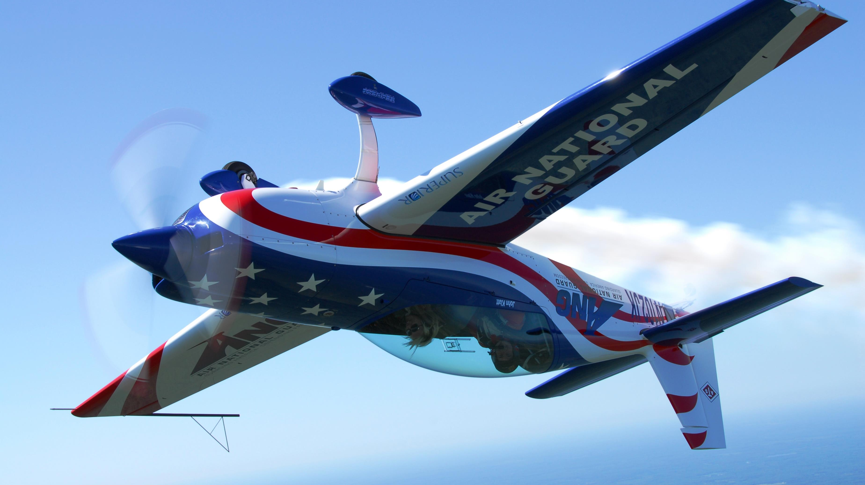
Somatosensory system…
The somatosensory system sends signals from the skin, joints, and muscles to the brain that are interpreted in relation to the Earth’s gravitational pull
Inputs from each movement update the body’s position to the brain “
Seat of the pants” flying is largely dependent upon these signals
Used in conjunction with visual and vestibular clues, these sensations can be fairly reliable. However, the body cannot distinguish between acceleration forces due to gravity and those resulting from maneuvering the aircraft, which can lead to sensory illusions and false impressions of an aircraft’s orientation and movement.
This Photo by Unknown Author is licensed under CC BY-SA
Notes:
The somatosensory system sends signals from the skin, joints, and muscles to the brain that are interpreted in relation to the Earth’s gravitational pull. These signals determine posture. Inputs from each movement update the body’s position to the brain on a constant basis. “Seat of the pants” flying is largely dependent upon these signals. Used in conjunction with visual and vestibular clues, these sensations can be fairly reliable. However, the body cannot distinguish between acceleration forces due to gravity and those resulting from maneuvering the aircraft, which can lead to sensory illusions and false impressions of an aircraft’s orientation and movement.
(Next Slide)

Slide 21
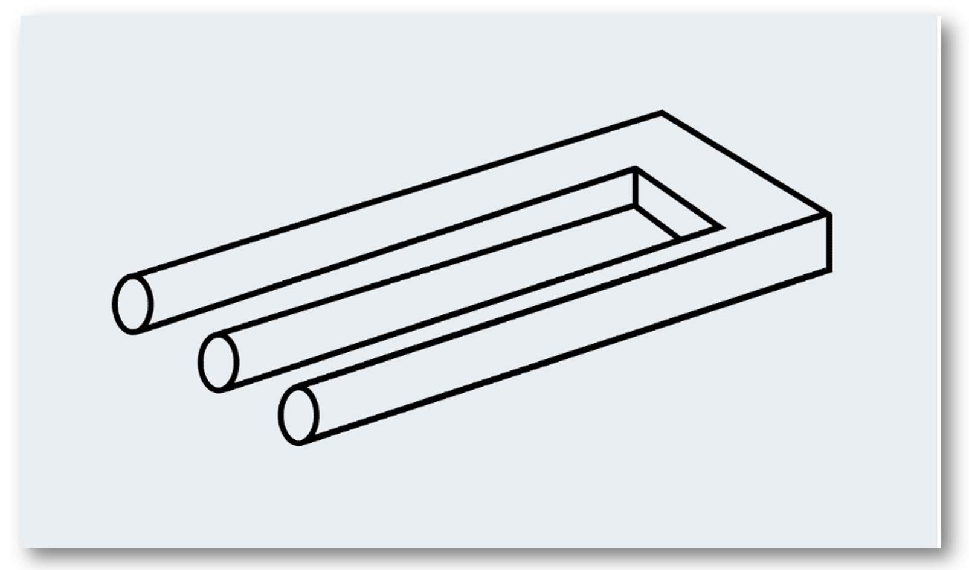
Perceptions …
Influence our decisions and actions
Misperceptions and Illusions
Identification
Compensation
Notes:
Perception is the way in which the brain understands information acquired through the senses.
The illustration on the right is an example of how our brains try to relate a 2-dimensional drawing to our 3-dimensional world. (Click)
Understanding perception is important because perceptions directly influence decisions we make and actions we take in response to perceived situations. (Click)
A critical part of that understanding has to do with identifying and compensating for misperceptions and illusions.
(Next Slide)

Slide 22
In Flight …
Situational and Spatial Awareness
Complications can compromise accurate
perception
Confirmation / Cross check
Human Bias
Notes:
In flight, our senses provide hundreds of informational bits that form the picture of our situational and spatial awareness. (Click)
But there are circumstances, such as maneuvering flight, night, and/or instrument meteorological conditions, that can dangerously compromise the accuracy of that picture. (Click)
That's why we confirm our sensory awareness with cockpit instrumentation and, when there is a disagreement, the instrument indications are trusted. (Click)
Human biases - preferential ways of treating information and weighing evidence - can influence our perceptions and the decisions based on them. We’ll take a look at one of them in the next slide.
(Next Slide)

Slide 23
Confirmation Bias... The tendency to organize and view information received in such a way as to confirm what we believe to be true
Physiological and lifestyle conditions and choices can also compromise information processing
Human Factors for Pilots Module 3: Human Performance
Notes:
Confirmation Bias has to do with our tendency to organize and view information received in such a way as to confirm what we believe to be true. In other words, we see, hear, and feel what we expect to sense. This bias can result in misinterpretation of and/or disregard for information that doesn't confirm our beliefs. Safe flight requires that we make objective assessments of our capabilities and circumstances in order to choose the best way forward. That includes looking for and considering information that might contradict our contentions. (Click)
As we noted in a previous forum; physiological and lifestyle conditions and choices can also affect our information processing. For more information, see: Human Factors for Pilots Module 3 - Human Performance.
Next, let's address the topic of Perceptual Illusions.
(Next Slide)

Slide 24
Visual Illusions
Notes:
Which Horizontal line is longer (a), or (b)? (Click)
The Muller-Lyre illusion consists of equal-length horizontal lines with 45-degree extensions. The outward facing extensions make line (a) appear to be longer than line (b)
(Next Slide)

Slide 25
Visual Illusions
Notes:
What do you see? The Rubin’s vase illusion can be seen as two human faces in profile or a vase.
(Next Slide)

Slide 26
Visual Illusions
Notes:
What color are the dots at the intersections of the lines? The Scintillating grid dark spots appear and disappear at random intersections. If you stare directly at a single intersection, you can’t see the dark dot. You may have seen these common illustrations before. They work with anyone who is not severely visually impaired.
(Next Slide)

Slide 27
Physiological Limitations
Blind spots can mask traffic or terrain
Color blindness
Low or high lighting conditions
Notes:
Some visual misperceptions result from physiological limitations in our eyes such as. (Click)
Blind spots that may mask traffic or terrain features,
color blindness that can make it difficult to identify runway and aircraft position lights,
and our inability to detect objects in very low or high lighting conditions.
Next, we’ll discuss some common visual illusions and how we and our students should deal with them.
(Next Slide)

Slide 28
Visual Physiological Illusions (Optical Illustions)
Autokinesis
When we stare at a light source against a dark background at night and there are no other visual references around it, we sense that the light source is moving.
Black hole approach
Approaching an airport over a large, unlit area; it's difficult to estimate your altitude relative to the ground. This can lead to overshooting, or more dangerously, undershooting the runway.
False horizons
When the natural horizon is not visible, we may reference terrain, clouds, or light instead.
Runway lights
Bright runway lights can cause us to feel we're lower than we actually are. This can lead to high, unstable approaches. Transition from IMC to VMC when landing
Notes:
So, what are some visual illusions that are common in aviation. Let’s discuss how best to deal with them. (Click)
Autokinesis
When we stare at a light source against a dark background at night and there are no other visual references around it, we sense that the light source is moving.
Shifting our gaze or looking to the side of the light source can reduce this phenomenon. (Click)
Black hole approach
Approaching an airport over a large, unlit area; it's difficult to estimate your altitude relative to the ground. This can lead to overshooting, or more dangerously, undershooting the runway.
Rely on aircraft instrumentation to determine your height in the pattern.
Avoid long final approach legs over unlit terrain or water. Flying a standard traffic pattern is a safer alternative.
If the runway is served by a precision approach, select the approach frequency for Glide Slope guidance.
Follow guidance provided by Visual Approach Slope Indicators. (Click)
False horizons
When the natural horizon is not visible, we may reference terrain, clouds, or light instead.
Rely on the Attitude Indicator for horizon information. (Click)
Runway lights
Bright runway lights can cause us to feel we're lower than we actually are. This can lead to high, unstable approaches.
Fly the recommended altitudes in the pattern and rely on electronic or visual approach slope indicators.
It’s not just runway lighting that can be deceiving. Runways themselves present numerous challenges.
(Next Slide)

Slide 29
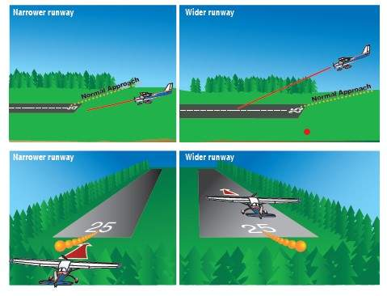
Runway Width
Narrow runways may cause us to sense we are higher than we actually are
Wide runways may cause us to sense we are lower than we actually are
Notes:
Narrow runways may cause us to feel we are higher than we actually are. That can lead to a lower approach
Wide runways may cause us to feel we are lower than we actually are.
In either case, fly the published traffic pattern and altitudes and confirm with electronic or visual glide slope information.
(Next Slide)

Slide 30
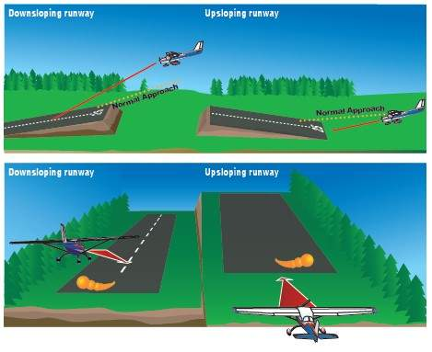
Runway Slope
Approaching down-sloping runways we may sense that we are too low.
When approaching runways that slope upwards, we may sense that we are too high.
Notes:
When approaching runways that slope upwards, we may feel that we are too high and compensate by flying lower running the risk of landing short or Controlled- Flight-Into-Terrain.
Approaching down-sloping runways we may feel that we are too low and compensate by flying a higher approach path and the risk of landing long and perhaps over-running the runway.
(Next Slide)

Slide 31
Precipitation
Rain can cause approach and runway lights to seem brighter at night, resulting in us feeling we are lower than we should be, and forcing us to overcorrect to a higher-than-normal approach.
Fog and haze can make the runway look further away than it is, creating an illusion of being too high. Similarly, fog or rain at the end of the runway can cause the illusion of a higher-than-normal approach, especially after becoming visual from an instrument approach. This can cause pilots to pushforward and ‘duck under’ the approach path.
Snow can cause a stroboscopic sensation
Rain
Fog and haze
Snow
Notes:
Rain can cause approach and runway lights to seem brighter at night, resulting in us feeling we are lower than we should be, and forcing us to overcorrect to a higher-than-normal approach.
Fog and haze can make the runway look further away than it is, creating an illusion of being too high. Similarly, fog or rain at the end of the runway can cause the illusion of a higher-than-normal approach, especially after becoming visual from an instrument approach. This can cause pilots to pushforward and ‘duck under’ the approach path.
(Next Slide)

Slide 32
Overcoming Visual Illusions
Anticipate illusions
Consult charts, diagrams, and photos
Check weather reports and forecasts
Use electronic and visual glide slope indications, instrument approaches and VDPs.
Maintain night proficiency
Don’t pursue VFR in deteriorating weather conditions
Always have an out
Notes:
Experienced pilots anticipate illusions. They know what weather, lighting, terrain, and runway features are likely to produce them. Study of airport charts, diagrams, and photographs goes a long way toward building a picture of what to expect. And frequent updating of weather reports and forecasts is essential to their success (Click)
Make use of electronic and visual glide slope indicators and maintain a safe maneuvering altitude until established on an instrument approach segment or reaching a Visual Descent Point. (Click)
Maintain pilot proficiency – especially at night. Don’t pursue VFR in deteriorating weather conditions and, of course, always have at least one alternative in mind.
So much for visual illusions. Next let’s discuss a class of illusions that’s even more dangerous – Kinesthetic Illusions.
(Next Slide)

Slide 33
Kinesthetic Illusions
Having to do with movement or sensation, especially within the body
May lead to Spatial Disorientation!
Notes:
Kinesthetic illusions can occur in circumstances under which our somatosensory (whole body) sensors together with vestibular (inner ear) sensors cannot be trusted. This is particularly true when, as in instrument flight, visual information is ambiguous or unavailable. Kinesthetic illusions are particularly dangerous as they may lead to Spatial Disorientation.
In extreme cases, pilots may find themselves in the bottom of a sensory vortex where all their information processing power is devoted to survival with none left over to reason themselves out of their predicaments. This is definitely not a place any pilot wants to be; where luck alone may determine whether we will live to fly another day.
(Next Slide)

Slide 34
Kinesthetic Illusions can occur in circumstances under which our somatosensory (whole body) sensors together with vestibular (inner ear) sensors cannot be trusted.
This is particularly true when, as in instrument flight, visual information is ambiguous or unavailable.
Kinesthetic illusions are particularly dangerous as they may lead to Spatial Disorientation.
In extreme cases, pilots may find themselves in the bottom of a sensory vortex where all information processing power is devoted to survival with none left to reason themselves out of their predicament.
This is definitely not a place we want to be—where luck alone may determine whether we will live to fly another day

Slide 35
Kinesthetic Illusions
The leans
Turn (bank) then abruptly return to straight and level
Misperception of banking in other direction so bank or lean in original direction
To prevent the leans, maintain an effective instrument scan and make standard rate, coordinated turns
Coriolis Illusions
Moving head quickly while established in turn. Feels like movement on a different axis
Never move your head quickly while flying, especially when you in IMC, visibility is limited, or the natural horizon is obscure. If you feel as if you are becoming disoriented, focus on the flight instruments and bring the aircraft to straight and level flight
Spiral Dives (Graveyard Spiral)
When rolling out of an established turn pilots may feel they’re turning in the opposite direction causing them to re-establish a turn in the original direction. Although you are turning, you will fell as if you are in a wings-level descent. Adding back pressure will tighten the turn and increase the rate of decent
Quickly self perpetuates—Rely on the flight instruments to level wings and return to a level-flight attitude
Notes:
The Leans … occur when entering a banked turn slowly or maintaining a banked turn for some time. In these cases, your inner ear sensors may report that you are not turning. If you abruptly return to straight and level flight, you feel as if you are banking in the opposite direction. If you act on this sensation, you may re-enter the turn or, if you maintain level flight, you may feel compelled to lean in opposition to the perceived turn.
To prevent the leans, maintain an effective instrument scan and make standard rate, coordinated turns. (Click)
Coriolis Illusions … occur when you are in a constant turn long enough for the inner ear fluid to cease moving, causing your brain to think you are flying straight and level. At this point, if you move your head to quickly you may feel that you are moving on a different axis. Responding to this sensation with flight control input may well result in a dangerous flight attitude.
Never move your head quickly while flying, especially when you are in IMC, visibility is limited, or the natural horizon is obscure. If you feel as if you are becoming disoriented, focus on the flight instruments and bring the aircraft to straight and level flight. (Click)
Spiral Dives … sometimes called Graveyard Spirals, can result when you've maintained a turn long enough for the inner ear fluid to stop moving. As you return to level flight, you will feel as if you've turned in the opposite direction and you resume the original turn. Although you are turning, you will fell as if you are in a wings-level descent. Adding back pressure will tighten the turn and increase the rate of decent.
Spiral dives can get out of hand quickly so it's imperative to rely on the flight instruments to level wings and return to a level-flight attitude.
(Next Slide)

Slide 36
Kinesthetic Illusions
Somatogravic Illusions
Rapid acceleration will feel like pitching up
Rapid deceleration will feel like pitching down
Fly on instruments
Inversion illusions
Abrupt pitch from climb attitude to level flight will feel like tumbling backwards.
Forward pressure will increase the illusion intensity.
Slow, steady control inputs are key to preventing Inversion Illusions
Elevator Illusion
Can occur when flying in up-and-down drafts resulting in aggressive pitch inputs
Instrument scan and smooth control inputs are key to coping with these illusions. In extreme cases, where maintaining altitude is impossible, reference the attitude indicator and maintain a wings level attitude
Notes:
Somatogravic illusions … can occur when you rapidly accelerate or decelerate. Acceleration will cause a sensation of pitching up and, without a horizon reference, pilots will feel compelled to pitch down to compensate. The reverse is true when rapidly decelerating. Here, pilots will feel compelled to compensate by pitching up which could lead to a stall.
As with most illusions, flying by reference to the flight instruments is the best way to deal with Somatogravic Illusions. (Click)
Inversion Illusions … when you abruptly pitch from a climb attitude to level flight. This can induce the feeling of tumbling backwards and, if you respond by increasing forward pressure, the intensity of the illusion will increase.
Slow, steady control inputs are key to preventing Inversion Illusions. (Click)
Elevator Illusions … can occur when experiencing up and down drafts. Rapid acceleration upwards can induce an aggressive nose down control input. Similarly, down drafts may cause pilots to aggressively pull up.
Instrument scan and smooth control inputs are key to coping with these illusions. In extreme cases, where maintaining altitude is impossible, reference the attitude indicator and maintain a wings level attitude.
(Next Slide)

Slide 37
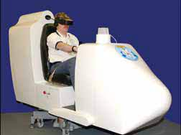
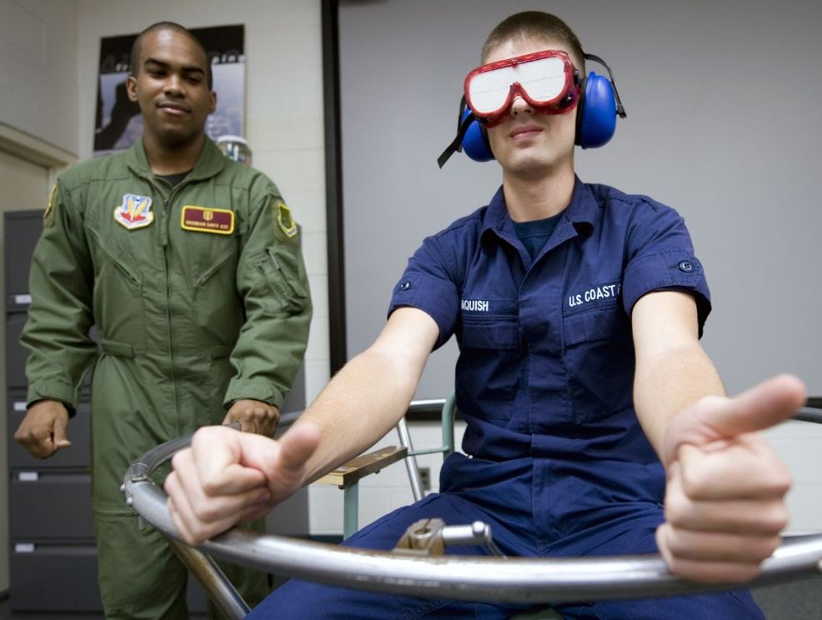
Vestibular illusions can be accentuated
Maintain a consistent head and body orientation
Moving one’s head can provoke spatial disorientation and vertigo
Participate in disorientation training
Notes:
As compelling as vestibular illusions are, they can be made worse. Seasoned pilots know to maintain a consistent head and body orientation. Moving one’s head in opposition to aircraft motion can provoke spatial disorientation and vertigo. The FAA, military, and civil flight training organizations offer disorientation training in a variety of devices. Pilots are encouraged to participate in this training where and when it is offered.
(Next Slide)

Slide 38
Auditory Misperceptions
Unclear transmissions
Rapid delivery
Accents
Ambiguous wording or TMI (too much information)
Unsuitable medium
Poor reception
Interference
Attention deficit (and confirmation bias)
Hearing what we expect (want) to hear
For more information see Human Factors Module 4: Communication.
Notes:
Auditory misperceptions can seriously compromise communication. Misperceptions may include:
Unclear transmissions in unfamiliar languages or accents, rapid delivery, ambiguous wording or simply too much information. Remember - the working memory can only hold three to five to nine informational bits. (Click)
Unsuitable transmission medium, poor radio reception, atmospheric or noisy environment interference
Lack of attention by the receiver, hearing what we expect (want) to hear. Remember our Conformation Bias discussion?
All this and more is covered in Human Factors Module 4: Communication.
(Next Slide)

Slide 39
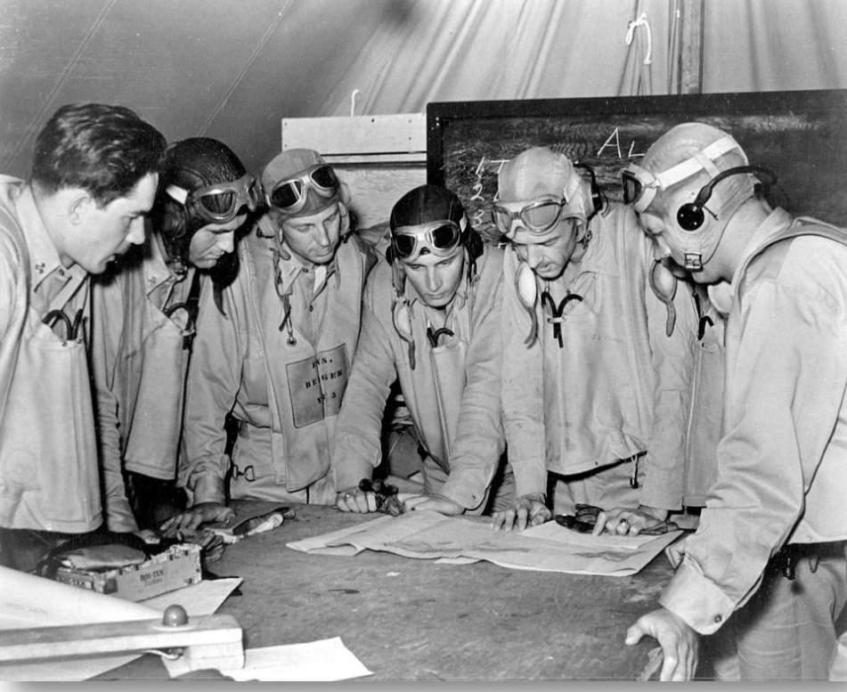
Deciding and Acting
Gathering Information
Deciding
Acting
Monitoring
Notes:
Decisions and actions are the end products of human information processing. Aeronautical decision making involves:
gathering information
deciding which actions will best suit our objectives
acting on our decisions and
monitoring the results of our actions.
(Next Slide)

Slide 40
Three More Things
Vigilance
Attention
Distraction
Notes:
Just three more points to make before we conclude this section. In order to process information effectively, we must be vigilant.
Vigilance refers to our state of awareness to external stimuli and readiness to react to a wide range of inputs. We can adjust the intensity of our vigilance, but it will be reduced by long periods of low stimulus, boredom, fatigue, and stress. Maintaining vigilance so as to be ready to deal with emergent circumstances as they arise, is an essential pilot skill. (Click)
We must also be attentive.
It's impossible to pay attention to all of our sensory input at the same time, so we must filter the stream of information and focus on what's important. Also, because it's impossible to do two or more things at the same time, we must often divide our attention to deal with multiple important issues. Like a good instrument scan that focuses briefly on each flight instrument, effective division of attention is a learned skill.
The most complex or unfamiliar tasks require our full attention, making it less likely that we will notice other important developments. For instance, while focusing on a complex arrival at an unfamiliar airport, we may omit important aircraft configuration requirements. Many gear-up landings have resulted from faulty attention management. (Click)
And we must effectively cope with distractions.
Distractions are common in aviation and everyday life. External distractions abound of course, but we are also easily distracted by our own thoughts. Internal distractions are more likely to occur when we're fatigued, stressed, or ill. In one noted accident, a commercial flight crew of four, while distracted in dealing with a gear status indicator, failed to notice a descent into terrain.
Managing focus and coping with distractions are essential pilot skills.
(Next Slide)

Slide 41
Three More Things
Vigilance
Vigilance refers to our state of awareness to external stimuli and readiness to react to a wide range of inputs.
We can adjust the intensity of our vigilance, but it will be reduced by long periods of low stimulus, boredom, fatigue, and stress.
Maintaining vigilance so as to be ready to deal with emergent circumstances as they arise, is an essential pilot skill.
Notes:
Just three more points to make before we conclude this section. In order to process information effectively, we must be vigilant.
Vigilance refers to our state of awareness to external stimuli and readiness to react to a wide range of inputs. We can adjust the intensity of our vigilance, but it will be reduced by long periods of low stimulus, boredom, fatigue, and stress. Maintaining vigilance so as to be ready to deal with emergent circumstances as they arise, is an essential pilot skill. (Click)
We must also be attentive.
It's impossible to pay attention to all of our sensory input at the same time, so we must filter the stream of information and focus on what's important. Also, because it's impossible to do two or more things at the same time, we must often divide our attention to deal with multiple important issues. Like a good instrument scan that focuses briefly on each flight instrument, effective division of attention is a learned skill.
The most complex or unfamiliar tasks require our full attention, making it less likely that we will notice other important developments. For instance, while focusing on a complex arrival at an unfamiliar airport, we may omit important aircraft configuration requirements. Many gear-up landings have resulted from faulty attention management. (Click)
And we must effectively cope with distractions.
Distractions are common in aviation and everyday life. External distractions abound of course, but we are also easily distracted by our own thoughts. Internal distractions are more likely to occur when we're fatigued, stressed, or ill. In one noted accident, a commercial flight crew of four, while distracted in dealing with a gear status indicator, failed to notice a descent into terrain.
Managing focus and coping with distractions are essential pilot skills.
(Next Slide)

Slide 42
Three More Things
Attention
It is impossible to pay attention to all of our sensory inputs simultaneously
We must filter the stream of information and focus on what's important
It is impossible to do two or more things at the same time, we must often divide our attention to deal with multiple important issues
Like a good instrument scan that focuses briefly on each flight instrument, effective division of attention is a learned skill
Complex or unfamiliar tasks require full attention, making it less likely that we notice other developments.
For instance, while focusing on a complex arrival at an unfamiliar airport, we may omit important aircraft configuration requirements. Many gear-up landings have resulted from faulty attention management
Notes:
Just three more points to make before we conclude this section. In order to process information effectively, we must be vigilant.
Vigilance refers to our state of awareness to external stimuli and readiness to react to a wide range of inputs. We can adjust the intensity of our vigilance, but it will be reduced by long periods of low stimulus, boredom, fatigue, and stress. Maintaining vigilance so as to be ready to deal with emergent circumstances as they arise, is an essential pilot skill. (Click)
We must also be attentive.
It's impossible to pay attention to all of our sensory input at the same time, so we must filter the stream of information and focus on what's important. Also, because it's impossible to do two or more things at the same time, we must often divide our attention to deal with multiple important issues. Like a good instrument scan that focuses briefly on each flight instrument, effective division of attention is a learned skill.
The most complex or unfamiliar tasks require our full attention, making it less likely that we will notice other important developments. For instance, while focusing on a complex arrival at an unfamiliar airport, we may omit important aircraft configuration requirements. Many gear-up landings have resulted from faulty attention management. (Click)
And we must effectively cope with distractions.
Distractions are common in aviation and everyday life. External distractions abound of course, but we are also easily distracted by our own thoughts. Internal distractions are more likely to occur when we're fatigued, stressed, or ill. In one noted accident, a commercial flight crew of four, while distracted in dealing with a gear status indicator, failed to notice a descent into terrain.
Managing focus and coping with distractions are essential pilot skills.
(Next Slide)

Slide 43
Three More Things
Distractions
Distractions are common in aviation and everyday life.
External distractions abound, but we are also easily distracted by our own thoughts.
Internal distractions are more likely to occur when we're fatigued, stressed, or ill.
In one noted accident, a commercial flight crew of four, while distracted in dealing with a gear status indicator, failed to notice a descent into terrain.
Managing focus and coping with distractions are essential pilot skills
Notes:
Just three more points to make before we conclude this section. In order to process information effectively, we must be vigilant.
Vigilance refers to our state of awareness to external stimuli and readiness to react to a wide range of inputs. We can adjust the intensity of our vigilance, but it will be reduced by long periods of low stimulus, boredom, fatigue, and stress. Maintaining vigilance so as to be ready to deal with emergent circumstances as they arise, is an essential pilot skill. (Click)
We must also be attentive.
It's impossible to pay attention to all of our sensory input at the same time, so we must filter the stream of information and focus on what's important. Also, because it's impossible to do two or more things at the same time, we must often divide our attention to deal with multiple important issues. Like a good instrument scan that focuses briefly on each flight instrument, effective division of attention is a learned skill.
The most complex or unfamiliar tasks require our full attention, making it less likely that we will notice other important developments. For instance, while focusing on a complex arrival at an unfamiliar airport, we may omit important aircraft configuration requirements. Many gear-up landings have resulted from faulty attention management. (Click)
And we must effectively cope with distractions.
Distractions are common in aviation and everyday life. External distractions abound of course, but we are also easily distracted by our own thoughts. Internal distractions are more likely to occur when we're fatigued, stressed, or ill. In one noted accident, a commercial flight crew of four, while distracted in dealing with a gear status indicator, failed to notice a descent into terrain.
Managing focus and coping with distractions are essential pilot skills.
(Next Slide)

Slide 44
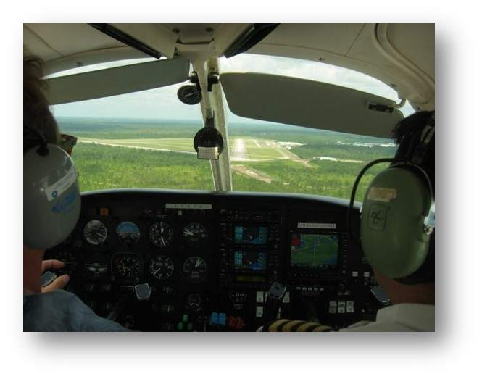
What We Can Do
Understand the process and be attuned to illusions
Control focus & minimize distractions
Night visual flying—reduced visual cues = danger
Instrument training—do it and practice it
Autopilots—reduce workload
Proficiency training and practice
We cannot revert to training unless…
Notes:
Human information processing is essential to flight safety. Pilots who understand the process have an advantage in dealing with misperceptions and illusions that could, if not dealt with, lead to accidents.
Successful pilots control their focus and minimize the impact of distractions.
Reduced visual cues and the increased potential for visual and Somatogravic illusions make Night VFR flying especially dangerous. Instrument training and equipment are great assets – especially at night. Autopilots can greatly reduce pilot workload and their use is encouraged with some significant caveats that we’ll discuss in the second half our program.
Most importantly, pilots must maintain their instrument skills through regular practice and training.
With that, we’ll move on to the final module in our Human Factors for Pilots series – Design and Automation.
(Next Slide)

Slide 45
Renew Your Human Factors Knowledge Here
http://bit.ly/HFcourses
Notes:
Speaking of educational journeys; you may have noticed this human factors promotional poster on airport bulletin boards. Your FAASTeam offers a great series of online Human Factors for Pilots courses. Navigate to the URL or scan the QR code on screen for a FAASTeam Human Factors course catalog that features direct links to each of the courses.
(Next Slide)

Slide 46
https://tinyurl.com/yv8jyhmv
Notes:
For more information on Safety Management, we recommend FAA’s Risk Management Handbook. It’s a great addition to every pilot’s library.
(Next Slide)

Slide 47
Proficiency and Peace of Mind
Regular scenario training with your CFI
Document in WINGS
Earn a phase: 3 + 3 in 12
Progressive flight review
Impress your insurance company
Notes:
There’s nothing like the feeling you get when you know you’re playing your A game and in order to do that you need a good coach (Click)
So fly regularly with a CFI who will challenge you to review what you know, explore new horizons, and to always do your best. Of course you’ll have to dedicate time and money to your proficiency program but it’s well worth it for the peace of mind that comes with confidence. (Click)
Vince Lombardi, the famous football coach said, “Practice does not make perfect. Only perfect practice makes perfect.” For pilots that means flying with precision. On course, on altitude, on speed all the time. (Click)
And be sure to document your achievement in the WINGS Proficiency Program. It’s a great way to stay on top of your game and keep you flight review current.
(Next Slide)

Slide 48
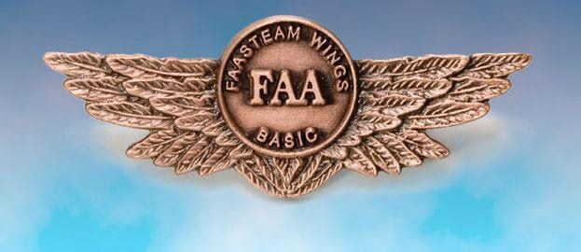
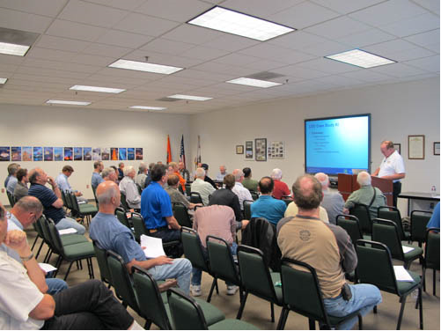
Thank You For Attending!
You are vital members of our GA safety community!
Notes:
Your presence here shows that you are vital members of our General Aviation Safety Community. The high standards you keep and the examples you set are a great credit to you and to GA.
Thank you for attending.
(Next Slide)

